Slide 1
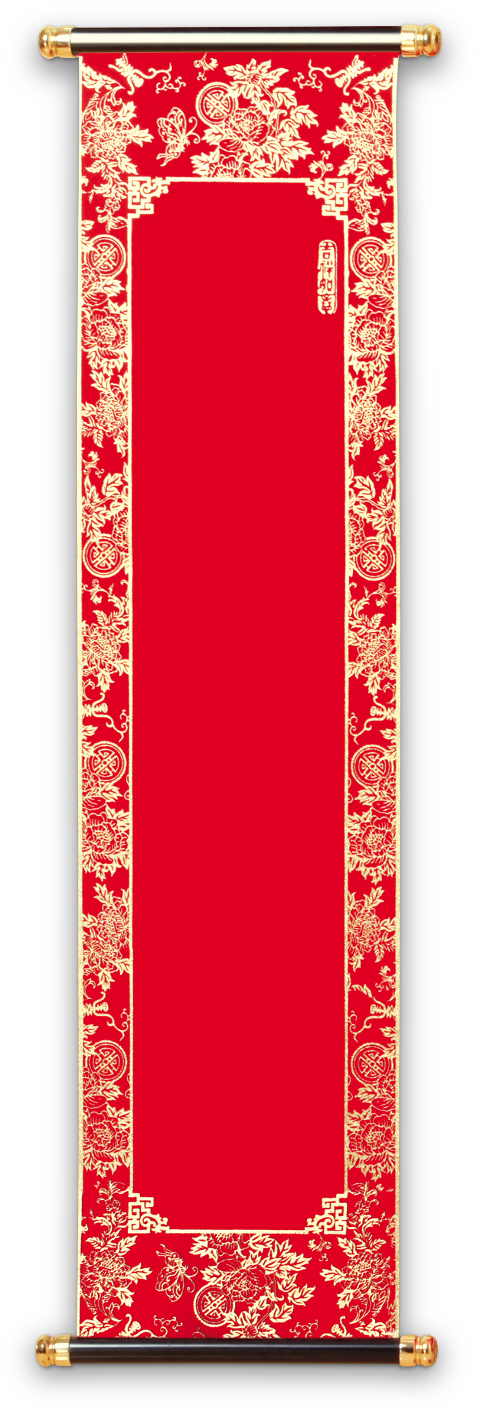
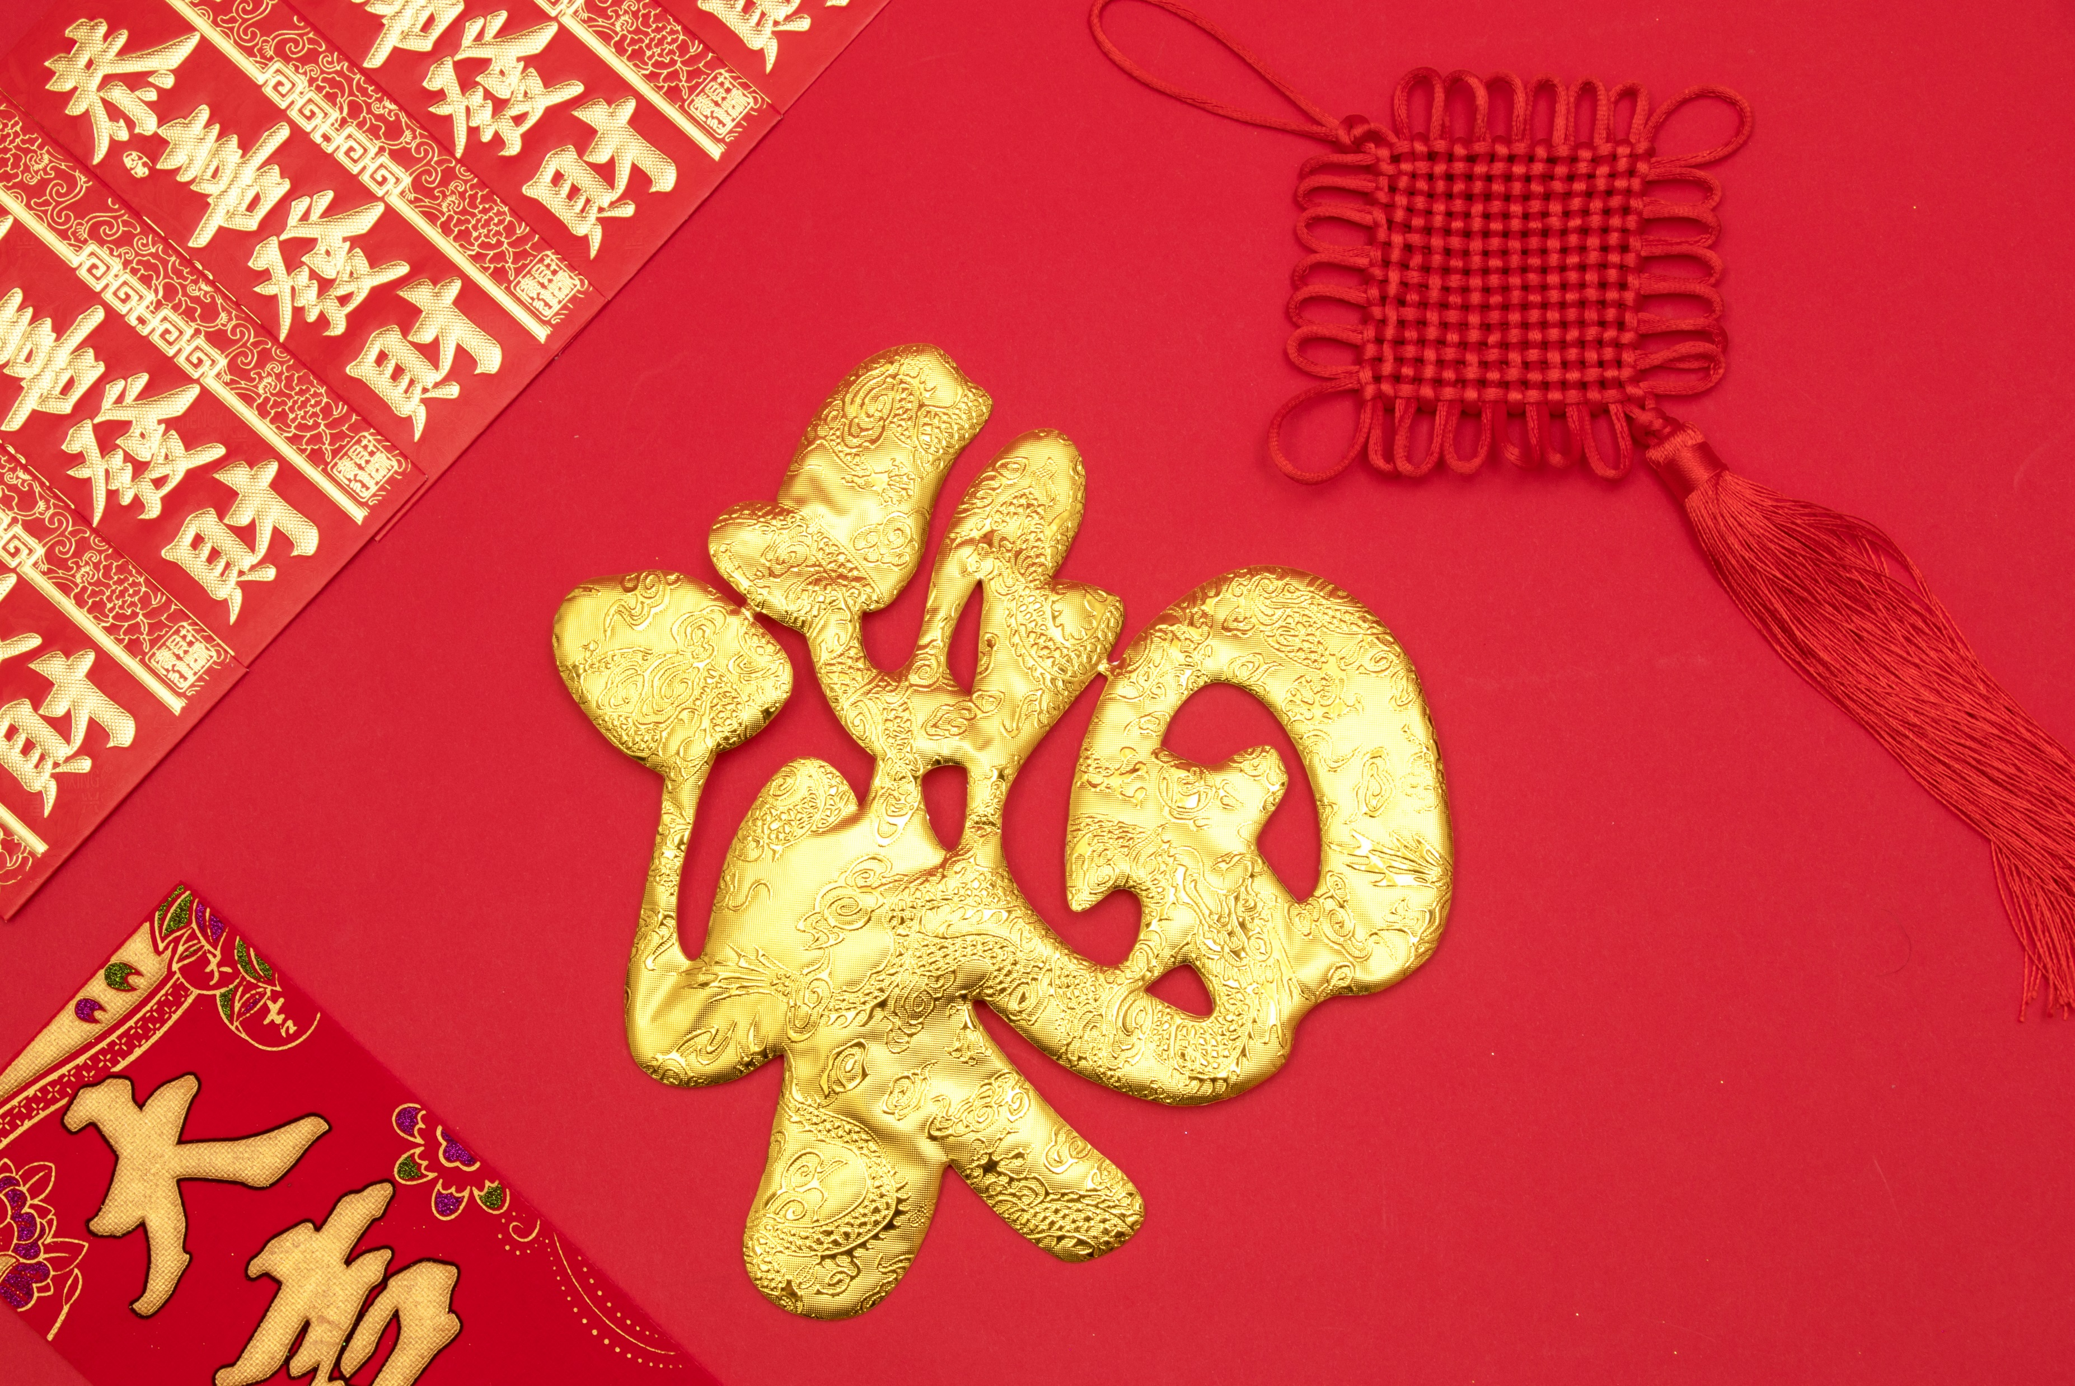

THE SPRING Couplets
春
联

Slide 2
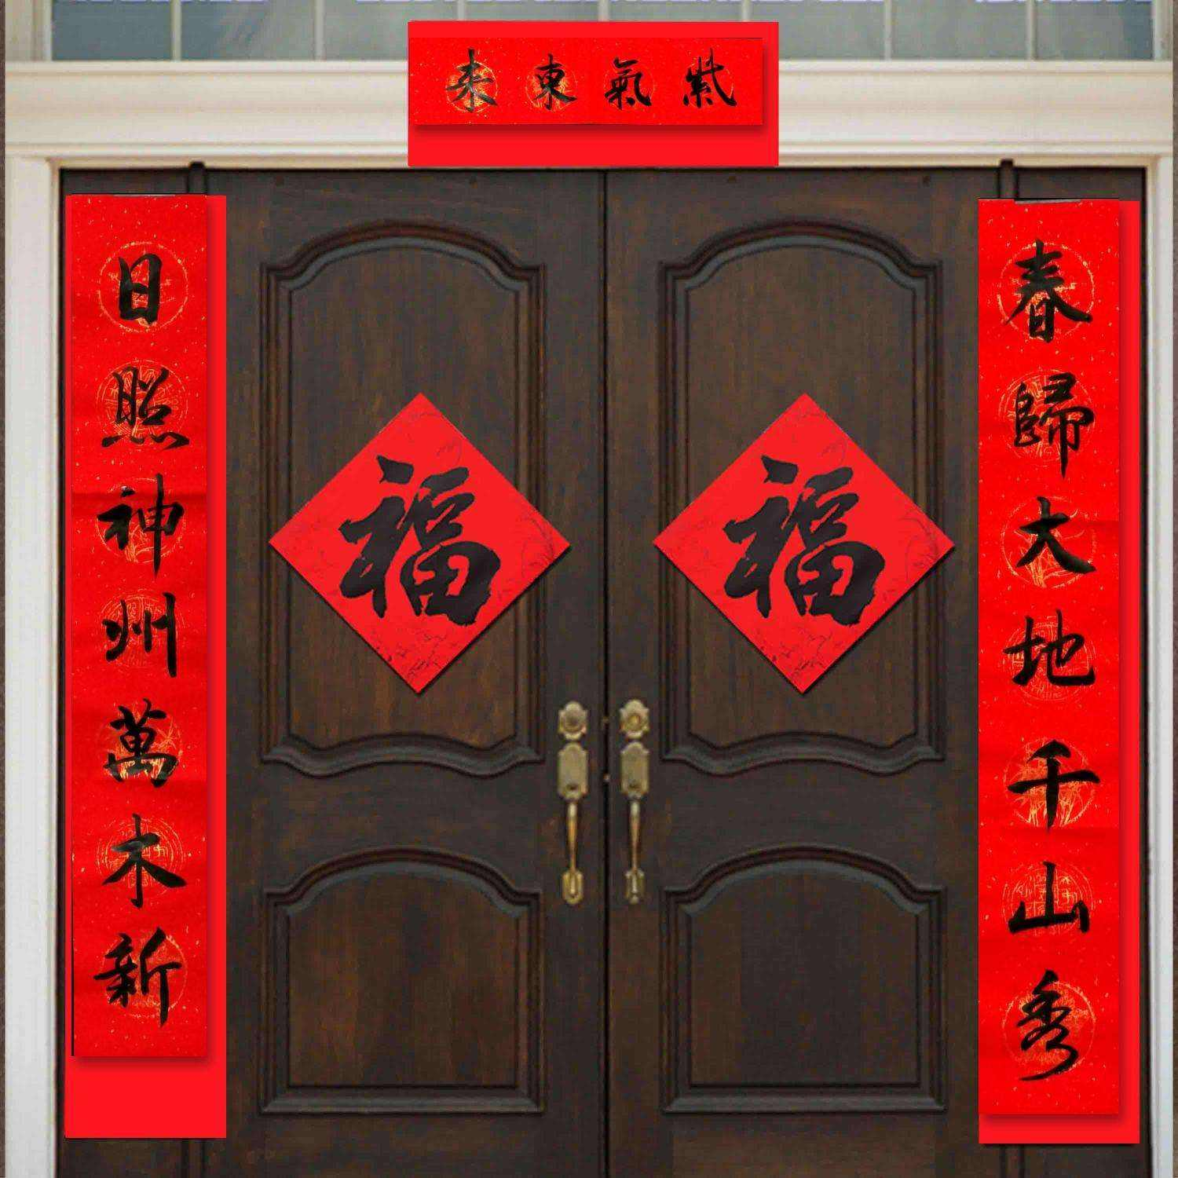
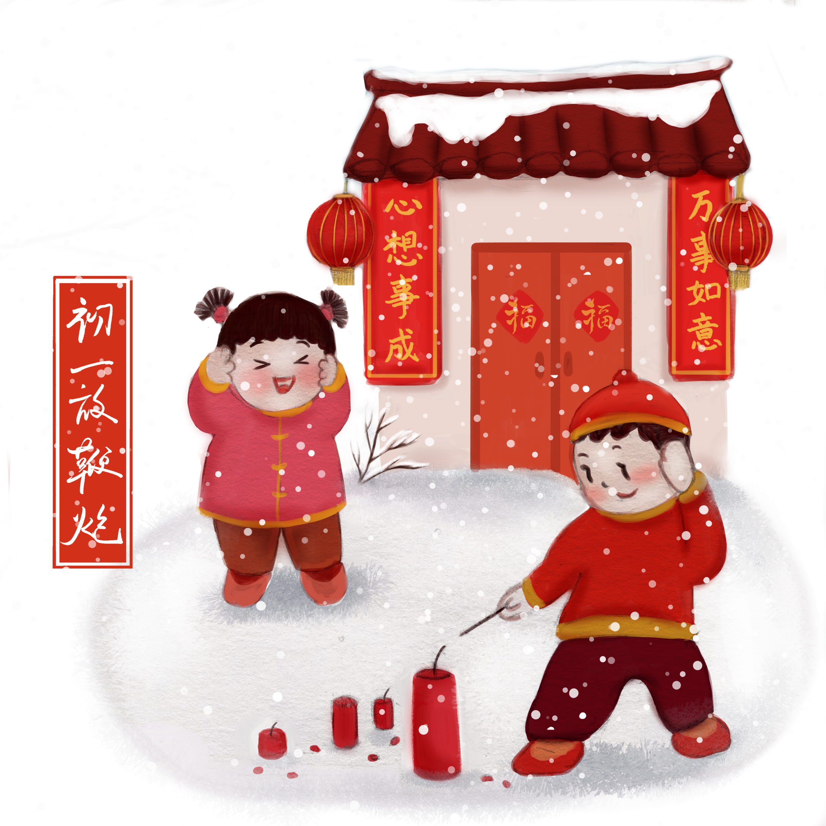
Spring Couplets
A pair of poetry lines vertically pasted on both sides of the front door and a four-character horizontal scroll affixed above
Wishes and Blessings.

Slide 3
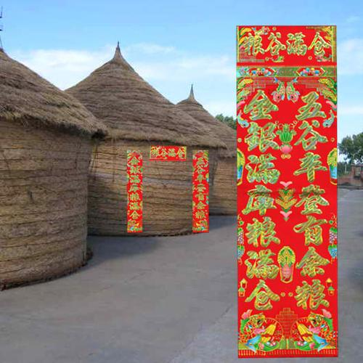
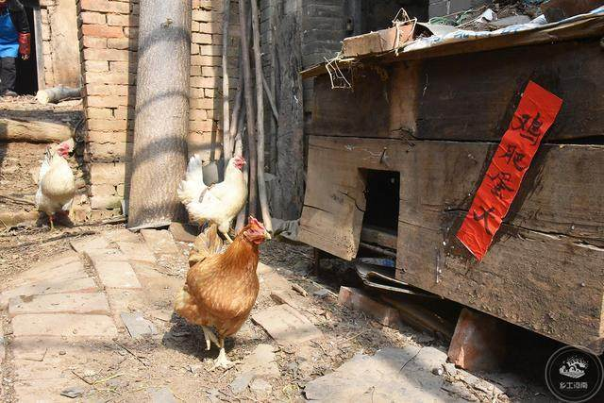
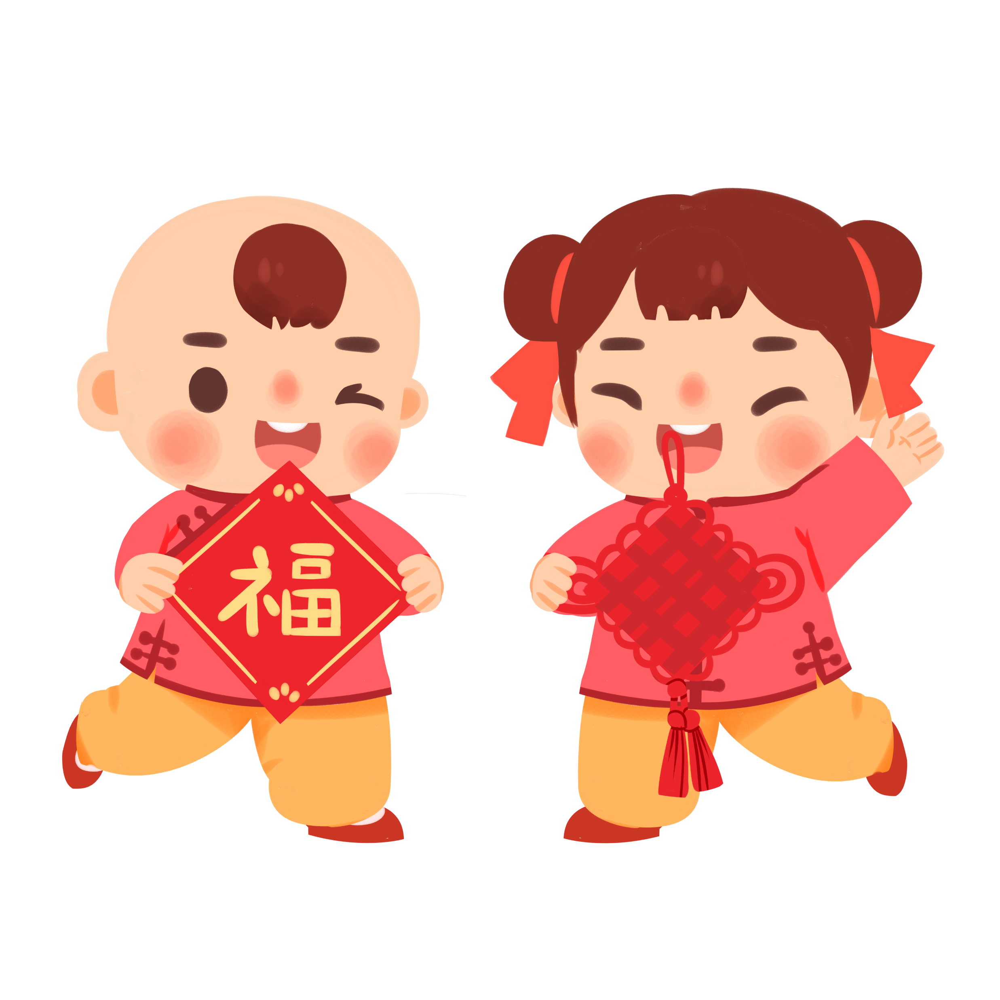
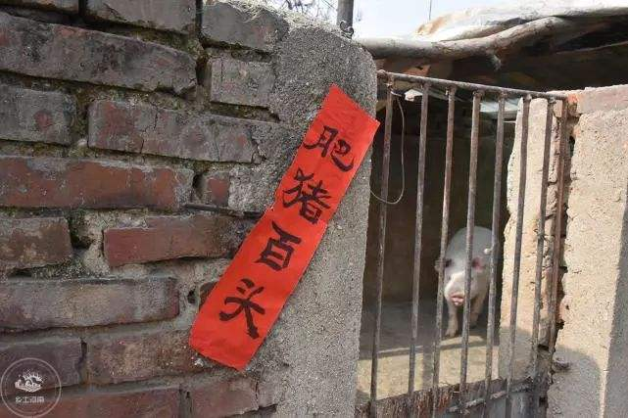
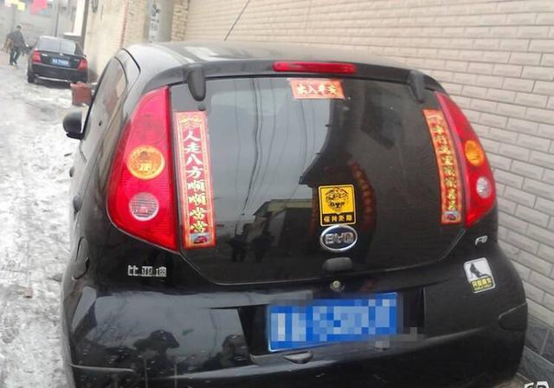
Paste your wishes anywhere
you wish it come true
Barn
Chicken House
Pig House
Car

Slide 4
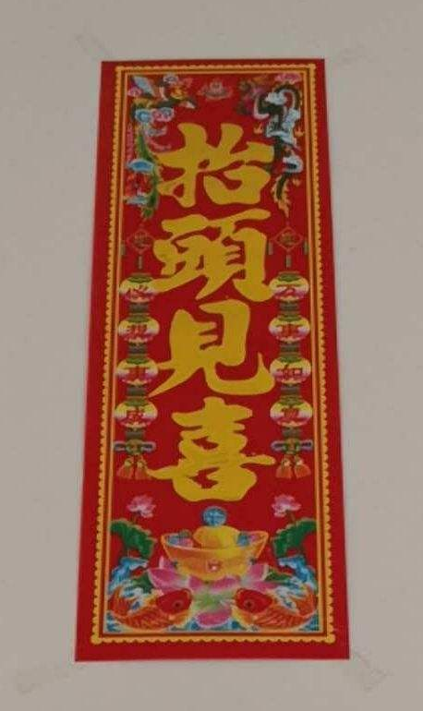
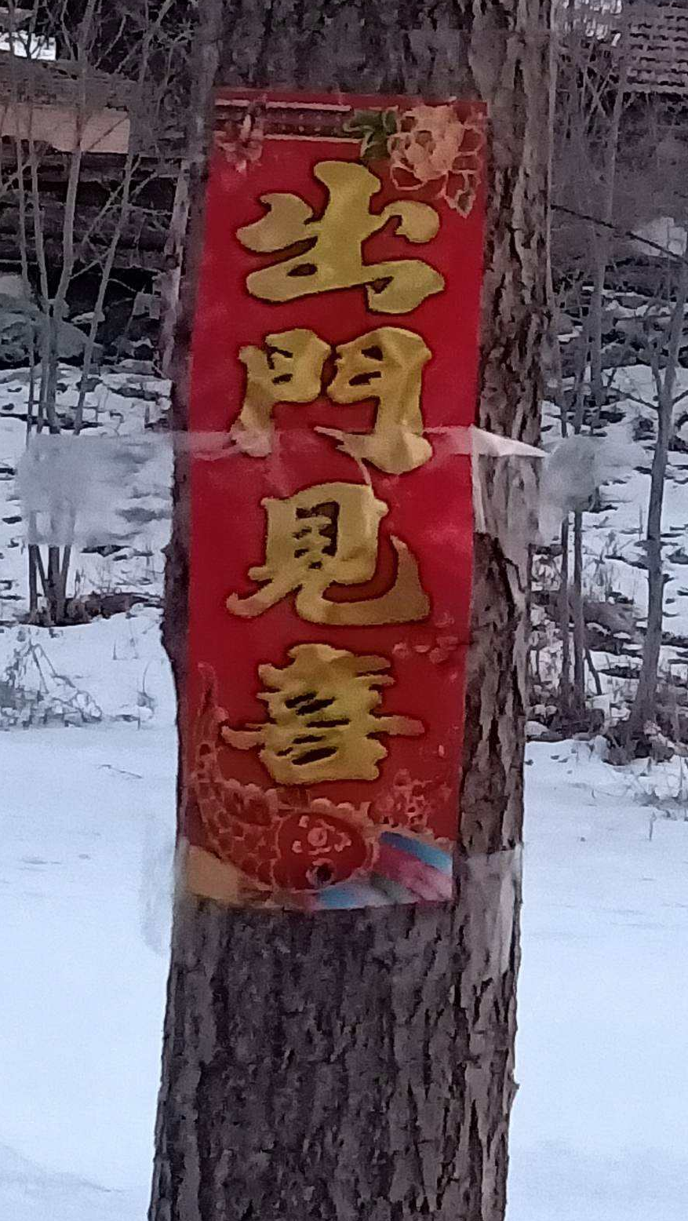
Interesting Couplets
Look up and see the Good Luck
Go outside and see the Good Luck

Slide 5


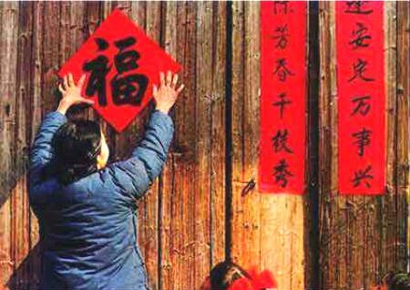
Character: Fu(福)
“Fu”(福) shows people yearning toward a good life.
Some people even invert the character “Fu” means “Fu” arrive in Chinese.

Slide 6
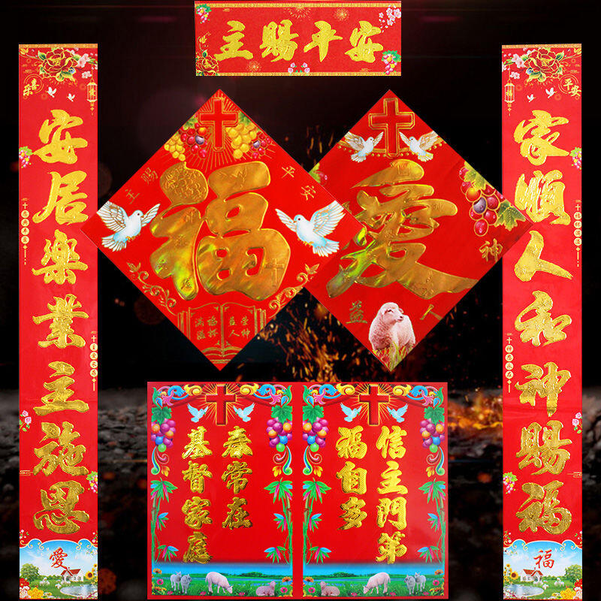
Christian Spring Couplets

Slide 7

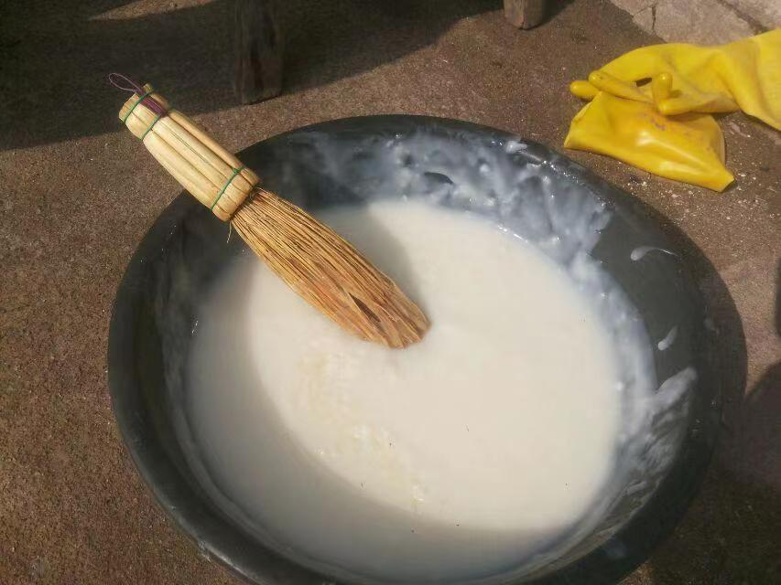
My Family Story about Spring Couplets
Special Glue: made of flour and water
Pasting the Spring couplets

Slide 8
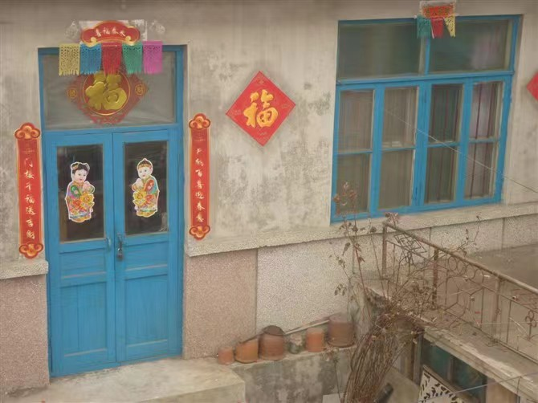
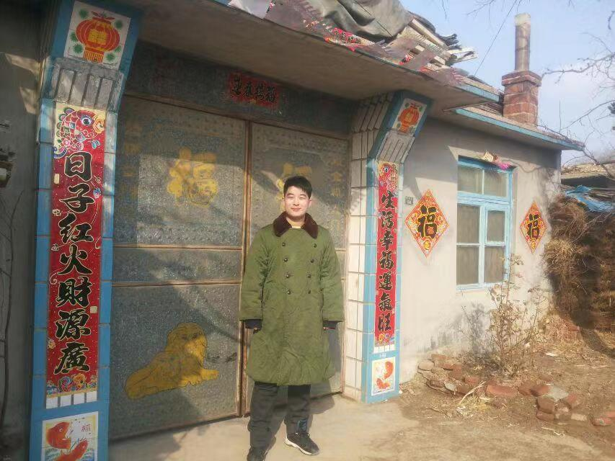
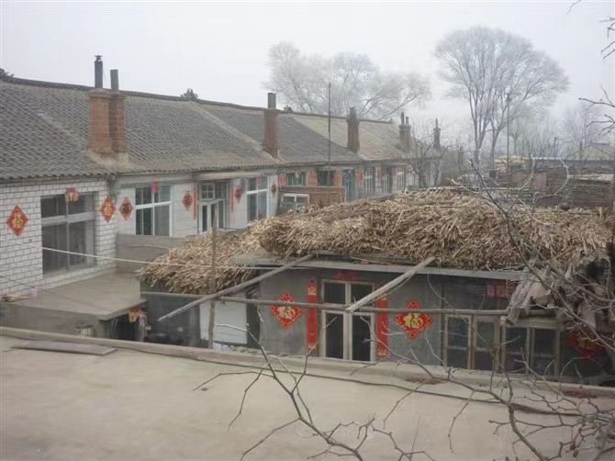
My Family Story about Spring Couplets

Slide 9
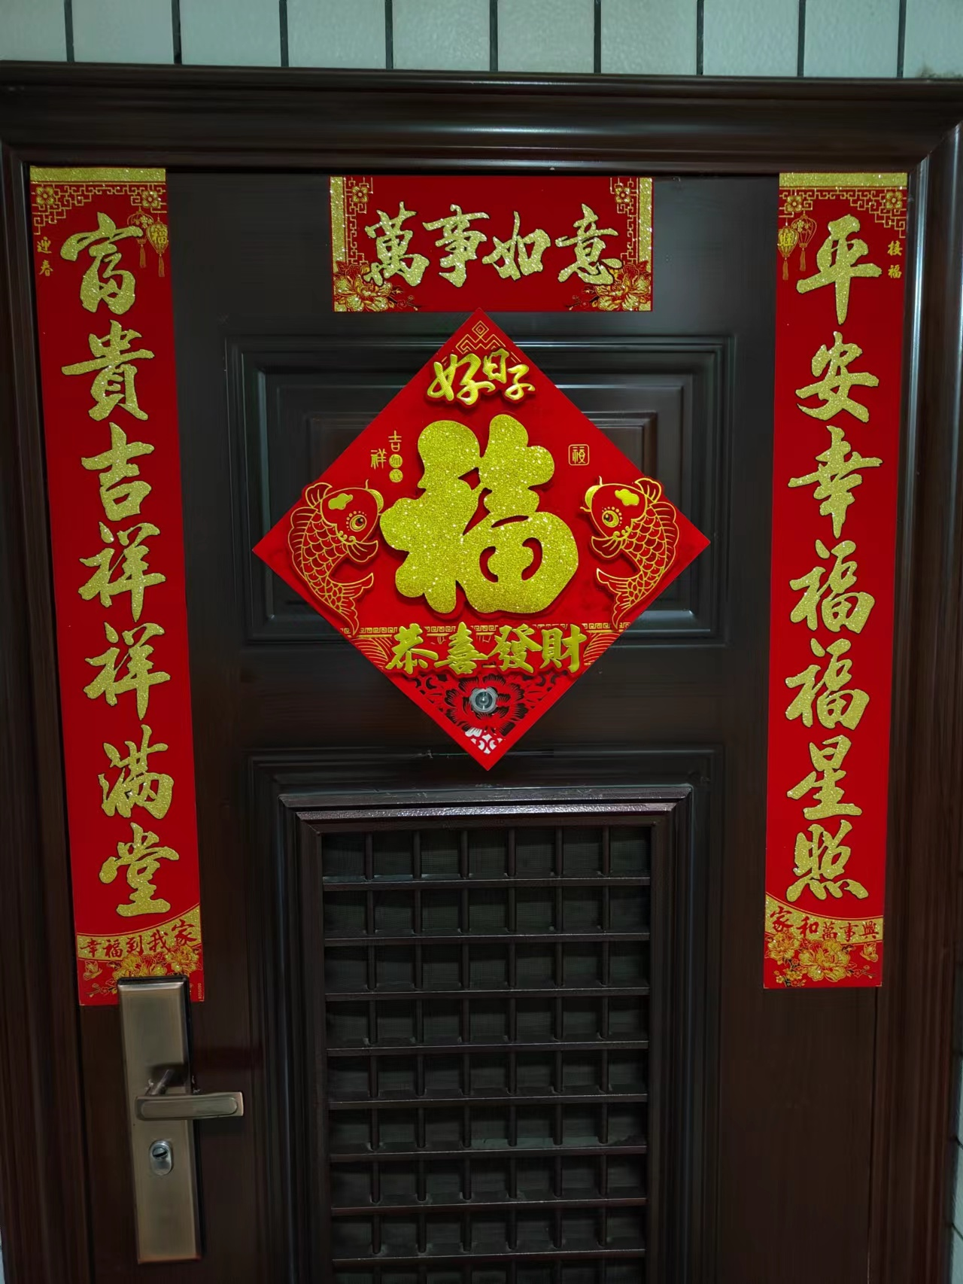
My Family Story about Spring Couplets
Pasting Spring Couplets becomes a lot easier when we move to the city.
Use tapes and don’t have to paste so many.

Slide 10
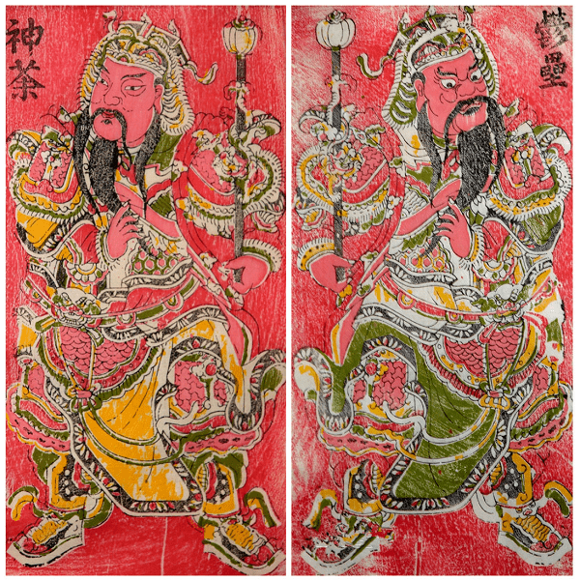
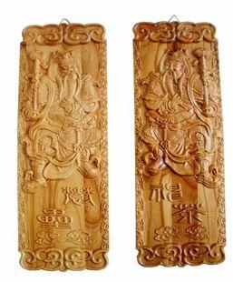
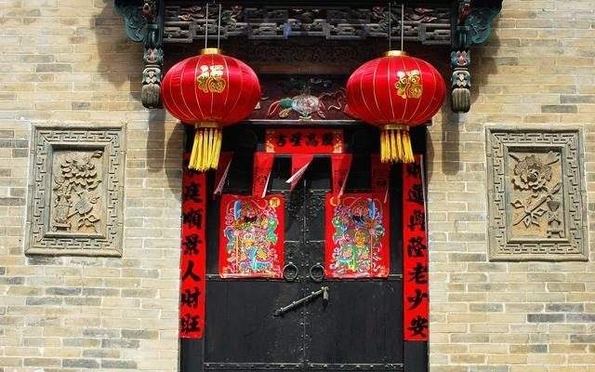
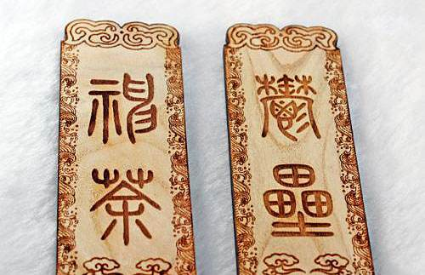
Origins of Spring Couplets
Two gods: 神荼(shēn shū) and郁垒(yù lǜ).
They catch Evils.

Slide 11
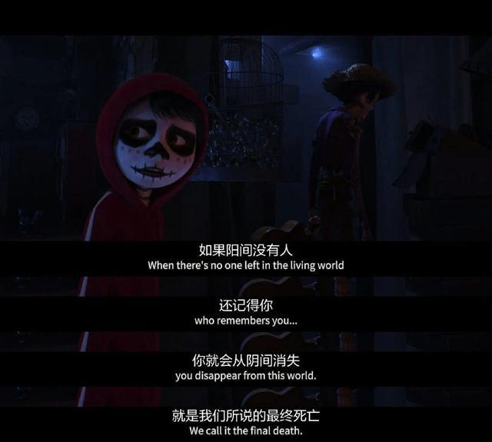
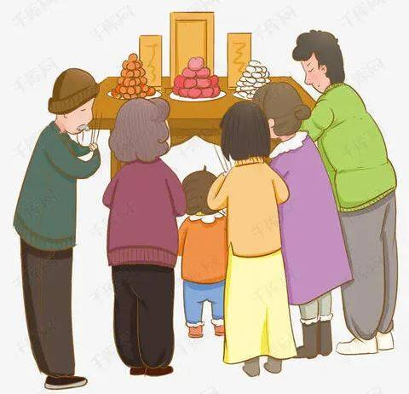
Some Family don't paste Spring Couplets
In memory of family members
The real death is that no one in the world remembers you.

Slide 12
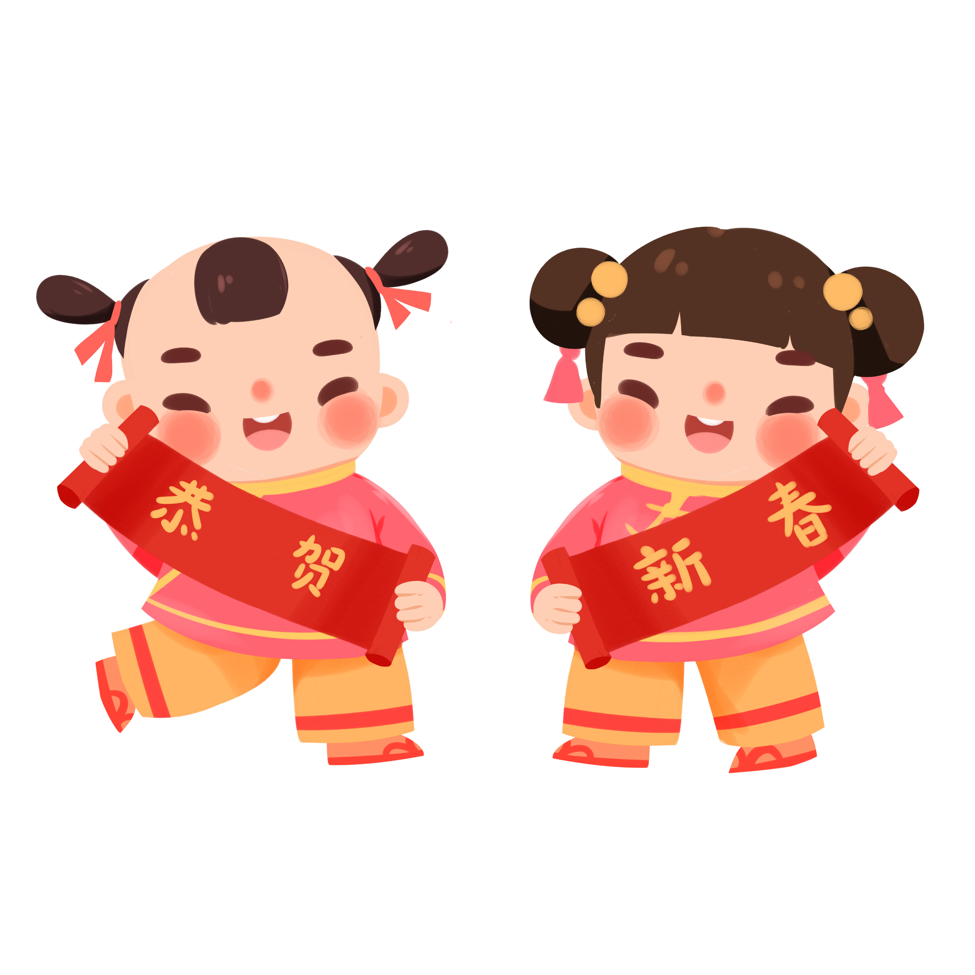
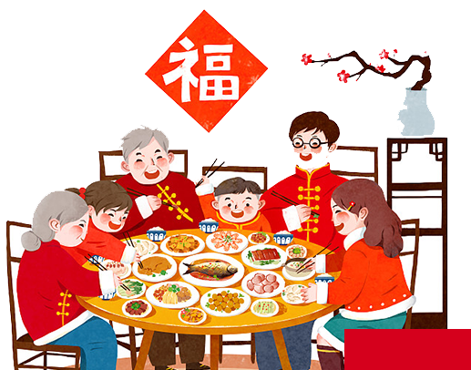
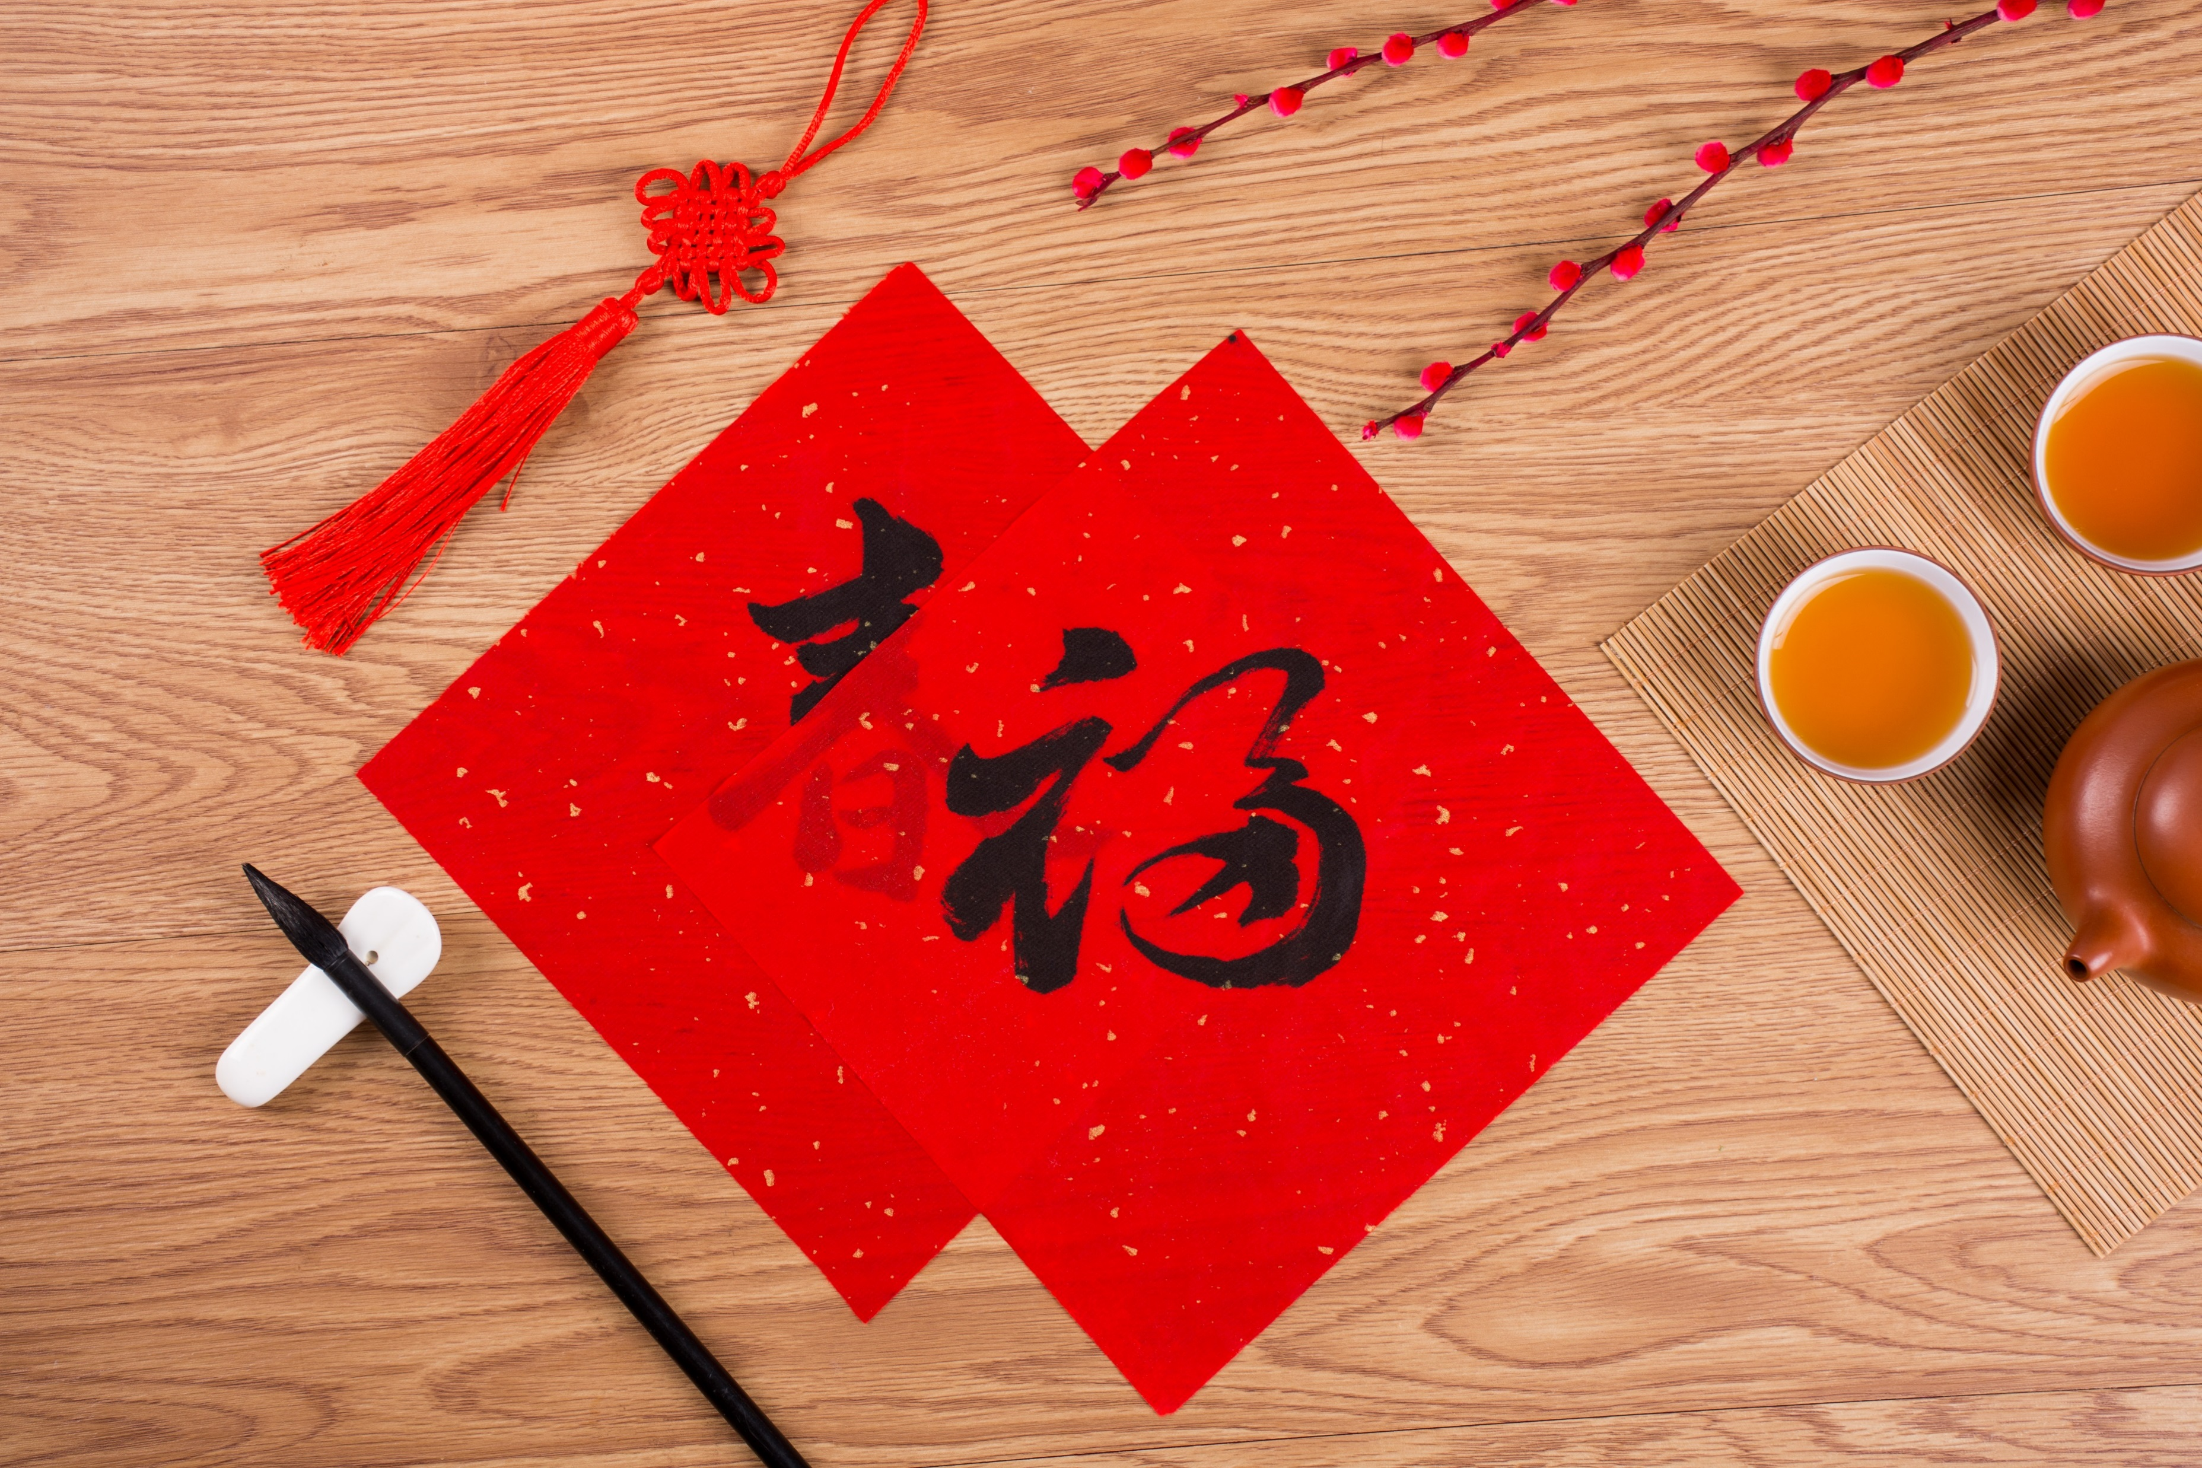
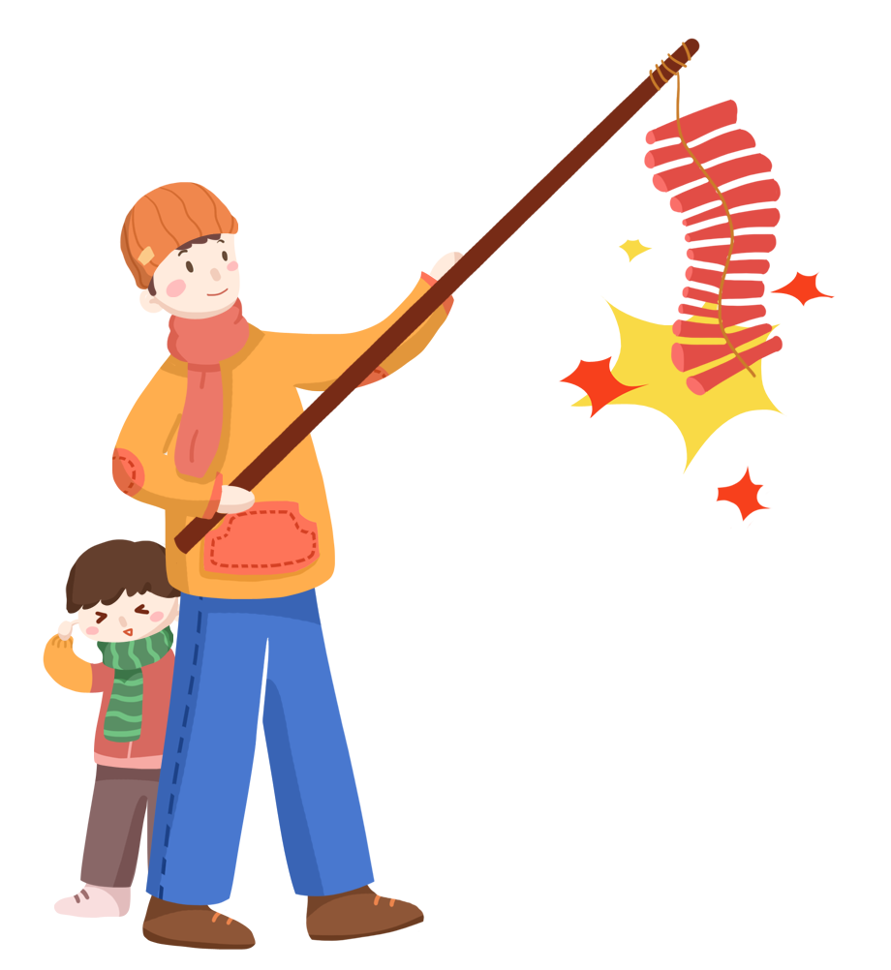
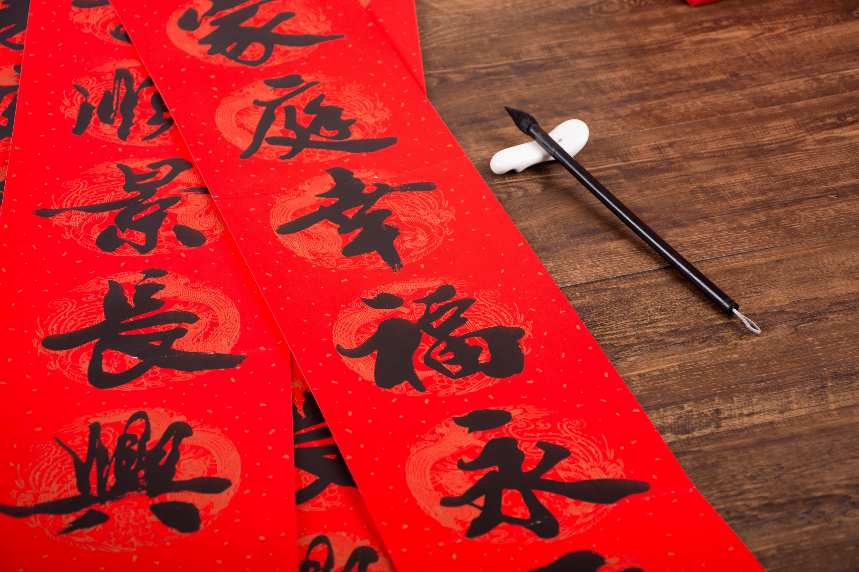

Spring Couplets
So, this is spring couplets.
It’s our tradition and custom.
It may change and evolve with the time goes.
What will not change is that it’s about the hope and the family.

Slide 13

Happy new year to you and your family!
Thank you!

